Slide 1
Course - DT228-2
Module (Subject) -
Human Computer Interaction
Semester 2, Week 7
DESIGN MODEL
Including Norman’s Model

Slide 2
Models (for Design)
Examples of Models
Norman’s Model
GOMs Model (Goals, Operators, Methods, Selection)
The Key-Stroke Level Model (KLM)
Etc…

Slide 3
Norman’s Action Model
To carry out a task
Form a goal
Execute the goal
Evaluate the result
HCI uses this as a cycle of ‘Do something’,
‘Check’…

Slide 4
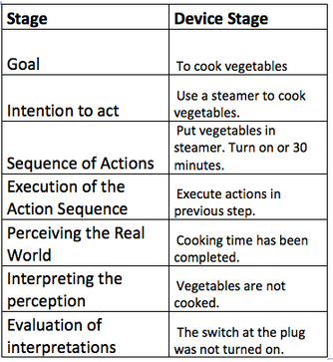
Norman’s Stages-of-Action Model

Slide 5
Principles Used in the Action Model
Principles used in the 7 Stages of Action model:
Visibility
Consistency
Feedback
Mapping

Slide 6
Gulf of Execution
The gulf of execution is the mismatch between the user’s intentions and the allowable actions.
How do I … ?
Close the Favourite tab
Open the door
Set the printer
Twist this cap off
What is the GAP between intention and action?

Slide 7
Gulf of Evaluation
The gulf of evaluation is the mismatch between the system’s representation and users expectations.
What happened?
Where was my file saved?
Is the air conditioner on?
Is the door locked?
Did you ever call a wrong number not picked up?
What is the GAP between perception and interpretation?

Slide 8
Gulfs of Execution and Evaluation
Gulf of Execution:
How does the user translate intentions into action?
Gulf of Evaluation:
How does the user understand the effects of actions and does s/he tell when her/his goals are satisfied?
Goals
Execution
World
Evaluation

Slide 9
Norman’s 7 Stages of action Model
Goals
1
Evaluation of
interpretations
Intention to act
2
7
Sequence of actions
3
6
Interpreting the
perception
Execution of the
Action sequence
5
Perceiving the state
of the world
4
THE WORLD

Slide 10
7 Stages of Action Model (2)
Cycle of Execution
Gulf of execution: Mismatch between the user's intentions and the allowable actions
3. Specify action
2. Intention
4. Execute action
1. Form
the goal
Conceptual
Model
(Goals)
Real World
(Interactions)
Gulf
7. Evaluate
5. Perceive system
state
Gulf of evaluation: Mismatch between the system's representation and the users' expectations
6. Interpret
Cycle of Evaluation
Theories

Slide 11
7 Stages of Action Model (3)
Four principles of good design
The state (of the function) and the action alternatives should be visible to the user
There should be a good conceptual model with a consistent system image
The interface should include good mappings that reveal the relationships between stages
The user should receive continuous feedback
Theories

Slide 12
Evaluation
Expert Reviews Evaluation Method:
Reviewers can use a variety of methods for example consistency inspection and cognitive walkthrough.
Reviewers should read manuals and test the interface as close as possible to a realistic work environment.

Slide 13
Norman’s Stages-of-Action Model
Can you identify Gulf of Execution?
Can you identify Gulf of Evaluation?

Slide 14
GOMS Model
GOMS (Goals, Operators, Methods, and Selection rules) is a kind of specialised human information processor model for HCI observation.
By decomposing users’ actions into small measurable steps, the GOMs model describes how users carry out a particular action.
This Model was able to predict expert behaviour by assuming error-free performance.

